Slide 1


Proposal for Implementing an IT Analytical System at "The Arena Group"
14 aug 2023
Bishal kamichhane –NP069450
Kritagya shahi-NP069462
Arjun Basnet-NP069444
.

Slide 2

Introduction
Purpose: To present a proposal for implementing a revolutionary management analytical system at "The Arena Group."
Content Overview: We will discuss the challenges faced, our proposed solutions, and the benefits of adopting this cutting-edge technology.

Slide 3
Problem
Inefficient Resource Allocation:
Struggles with optimal allocation of finances, manpower, and time.
Resulting in misallocated resources, project delays, and increased operational costs.
Lack of Real-time Data Insights:
Absence of a centralized management analytical system.
Reliance on manual data collection and disjointed systems.
Limited Forecasting Capability:
Difficulty in forecasting market trends, customer preferences, and industry shifts.
Reactive approach to events rather than proactive strategy shaping.

Slide 4
Proposed Solution
Data Insights:
Intuitive dashboards and customizable reports.
Real-time view of key performance indicators and critical metrics.
Predictive Analytics:
Leverage historical data and advanced algorithms.
Predict market trends, customer behavior, and demand fluctuations.
Resource Allocation Optimization:
Facilitate data-driven resource allocation.
Optimal allocation of finances, manpower, and time.
Improved efficiency and reduced costs.
Streamlined Decision-Making:
Empower decision-makers with accurate data insights.
Swift and informed choices for competitiveness and agility.
Long-term Growth Potential:
Embrace data-driven strategies and foster innovation.
Position for sustained growth, operational excellence, and industry leadership.

Slide 5
Scope of the Project
Needs Assessment and System Customization:
In-depth analysis of company requirements and pain points.
Customization of the system to align with unique operations and strategic objectives.
System Development and Integration:
Expert development team for system design and creation.
Seamless integration with existing infrastructure.
Centralized data sources for efficient collection, processing, and analysis.
Real-time Data Insights and Predictive Analytics:
Provide real-time data insights via intuitive dashboards and reports.
Predictive analytics for identifying market trends and opportunities.
Empower proactive decision-making.
User Training and Onboarding:
Comprehensive training sessions for team members.
Familiarization with interface, data visualization, and analytics features.

Slide 6
Qualifications
Bishal Lamichhane - CEO and Project Lead:
Over 15 years of IT solutions delivery experience.
Successful project oversight across diverse industries.
Leadership driving innovation and excellence at XEROX IT Pvt. Ltd.
Krish - Chief Data Scientist:
Holds a Ph.D. in Data Science.
Expertise in predictive analytics and machine learning.
Led data-driven initiatives delivering remarkable outcomes.
Arjun Basnet - Project Manager:
Proficiency in flawless project management.
Strong communication skills and attention to detail.
Ensures on-time delivery within scope.

Slide 7
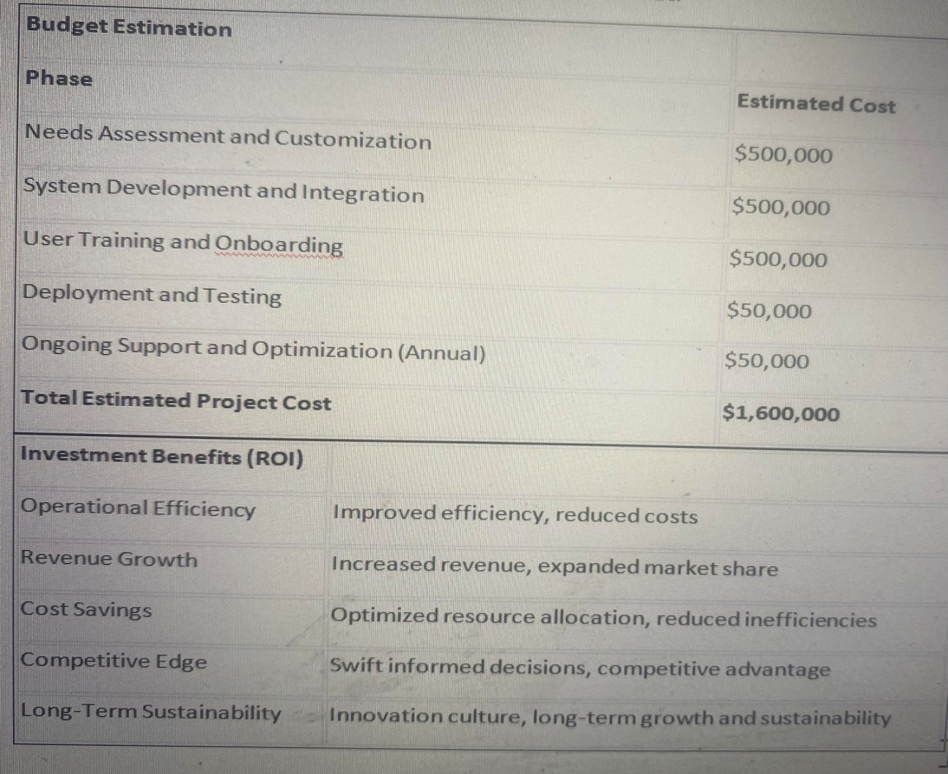
Budget Estimation

Slide 8
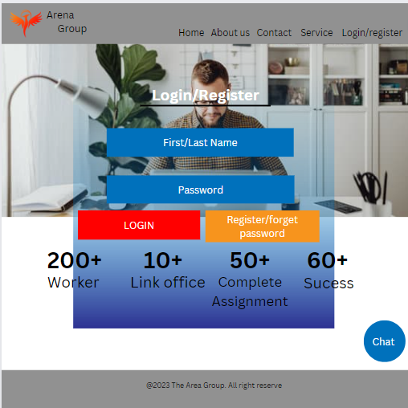
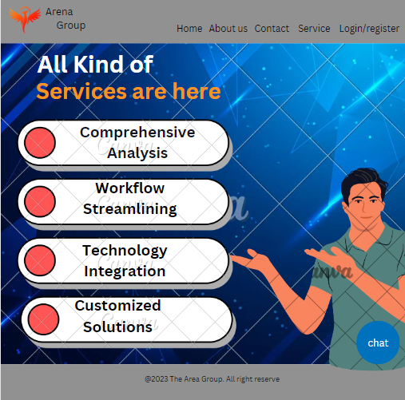
Picture:

Slide 9
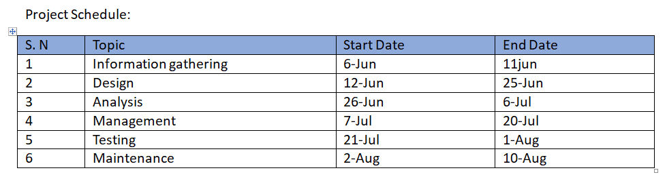
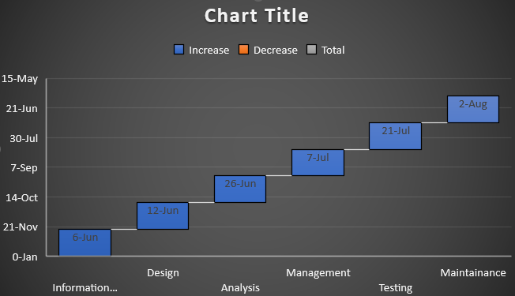
Gantt chart:

Slide 10
Implementation Plan
Project Initiation:
Kick-off, stakeholder alignment, and objective setting.
Establish clear communication channels.
Define roles and responsibilities of both teams.
Needs Assessment and Customization:
Experts understand specific requirements.
Tailor the system to align with your company's needs.
Map data sources and integration points.
System Development and Integration:
Use cutting-edge technology for system design.
Develop the management analytical system.
Meticulously integrate with existing systems and databases.
User Training and Onboarding:
Conduct comprehensive training sessions.
Familiarize your team with system features and navigation.
Ensure effective utilization of system capabilities.
Deployment and Testing:
Deploy system in a controlled environment.
Rigorous testing for performance, security, and data accuracy.
Smooth transition to live operations.
Ongoing Support and Optimization:
Provide post-deployment support for queries and issues.
Regular updates and optimizations for enhanced performance.
Incorporate new features as needed.

Slide 11

Conclusion
Opportunity for Growth:
Implementation by XEROX IT Pvt. Ltd. as a pivotal chance for "The Arena Group."
Overcome challenges and drive sustainable growth.
Key Benefits:
Seamless integration of real-time data insights, predictive analytics, and resource allocation.
Transition to a data-driven operational model.
Empower swift and informed decision-making.
Potential Gains:
Increased operational efficiency.
Revenue growth and market expansion.
Significant cost savings.
Gain a competitive advantage.
Strategic Investment:
Project as a strategic investment in future success.

